Slide 1
Mechanisms and Robotics DE ES DM ZG561
Lecture-11

Slide 2
Robot Dynamics
Robot Dynamics
Dynamics of a 2 dof RR Manipulator
Dynamics of a 2 dof R-θ Manipulator

Slide 3
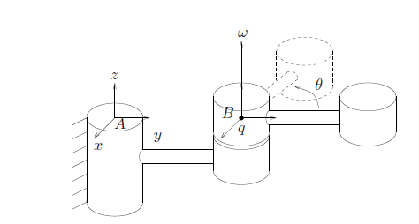
Robot Dynamics
Dynamics can be defined as the analysis of moving bodies.
Forces and their effects acting on machine parts in motion

Slide 4
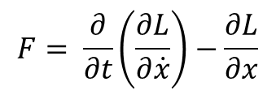
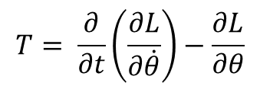
Lagrangian Mechanics
Lagrangian of a mechanical system is given by
L = K - P
$$T= \frac{∂}{∂t}\left(\frac{∂L}{∂\dot{θ}}\right)−\frac{∂L}{∂θ}$$
$$F= \frac{∂}{∂t}\left(\frac{∂L}{∂\dot{x}}\right)−\frac{∂L}{∂x}$$

Slide 5
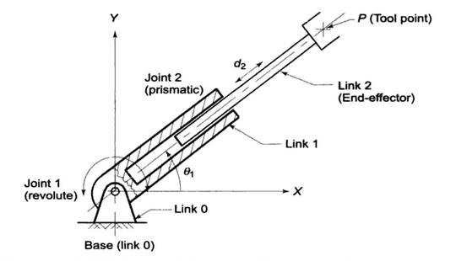
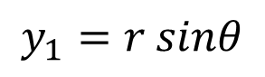
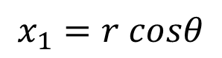
Dynamics of a θ-r manipulator
$$x_{1}=r cosθ$$
$$y_{1}=r sinθ$$

Slide 6
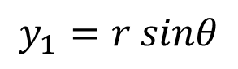
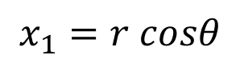
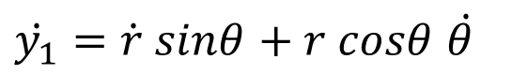
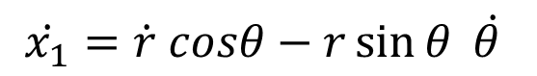
Dynamics of a θ-r manipulator
$$x_{1}=r cosθ$$
$$y_{1}=r sinθ$$
$$\dot{x_{1}}=\dot{r} cosθ−r\sin{θ }\dot{θ }$$
$\dot{y_{1}}=\dot{r} sinθ$ $+ r cosθ$ $\dot{θ }$

Slide 7
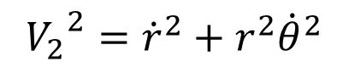
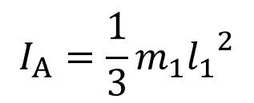
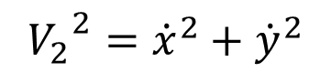
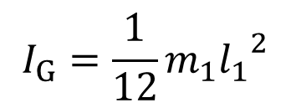
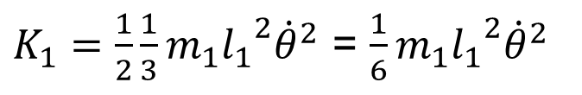
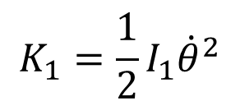
Dynamics of a θ-r manipulator
$${V_{2}}^{2}={\dot{x}}^{2}+{\dot{y}}^{2}$$
$${V_{2}}^{2}={\dot{r}}^{2}+r^{2}{\dot{θ}}^{2}$$
Mass Moment of Inertia about the CG of the link
$$K_{1}=\frac{1}{2}I_{1}{\dot{θ}}^{2}$$
$$I_{G}=\frac{1}{12}{{m_{1}l}_{1}}^{2}$$
Mass Moment of Inertia about one end of the link
$K_{1}=\frac{1}{2}{\frac{1}{3}m}_{1}{l_{1}}^{2}{\dot{θ}}^{2}$ = ${\frac{1}{6}m}_{1}{l_{1}}^{2}{\dot{θ}}^{2}$
$$I_{A}=\frac{1}{3}{{m_{1}l}_{1}}^{2}$$

Slide 8
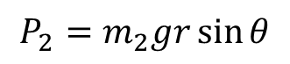
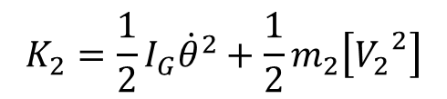
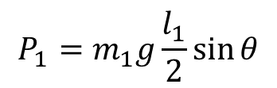
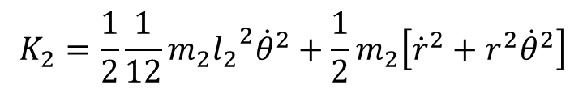
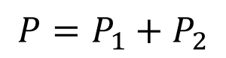
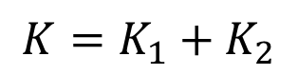
Dynamics of a θ-r manipulator
For Kinetic energy of the second link, r is not constant
$$K_{2}=\frac{1}{2}I_{G}{\dot{θ}}^{2}+\frac{1}{2}m_{2}\left[{V_{2}}^{2}\right]$$
$$K_{2}=\frac{1}{2}{\frac{1}{12}m}_{2}{l_{2}}^{2}{\dot{θ}}^{2}+\frac{1}{2}m_{2}\left[{{\dot{r}}^{2}+r}^{2}{\dot{θ}}^{2}\right]$$
$$P_{1}=m_{1}g\frac{l_{1}}{2}\sin{θ}$$
$$P_{2}=m_{2}gr\sin{θ}$$
$$K=K_{1}+K_{2}$$
$$P=P_{1}+P_{2}$$
L = K - P

Slide 9
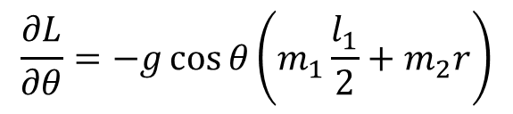
Dynamics of a θ-r manipulator
$\frac{∂}{∂t}\left(\frac{∂L}{∂\dot{θ}}\right)=\left({\frac{1}{3}m}_{1}{l_{1}}^{2}+{\frac{1}{12}m}_{2}{l_{2}}^{2}+m_{2}r^{2}\right)\ddot{θ}+2m_{2}$r $\dot{r}\dot{θ}$
$$\frac{∂L}{∂θ}=−g\cos{θ}\left(m_{1}\frac{l_{1}}{2}+m_{2}r\right)$$
Torque about the rotational actuator
$$T_{θ}=\left({\frac{1}{3}m}_{1}{l_{1}}^{2}+{\frac{1}{12}m}_{2}{l_{2}}^{2}+m_{2}r^{2}\right)\ddot{θ}+2m_{2}\text{r} \dot{r}\dot{θ}+g\cos{θ}\left(m_{1}\frac{l_{1}}{2}+m_{2}r\right)$$

Slide 10
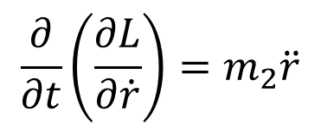
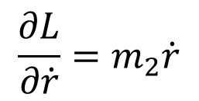
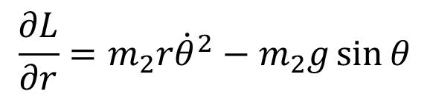
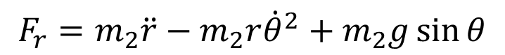
Dynamics of a θ-r manipulator
$$\frac{∂L}{∂\dot{r}}=m_{2}\dot{r}$$
$$\frac{∂}{∂t}\left(\frac{∂L}{∂\dot{r}}\right)=m_{2}\ddot{r}$$
$$\frac{∂L}{∂r}=m_{2}r{\dot{θ}}^{2}−m_{2}g\sin{θ}$$
Force applied by the linear actuator
$$F_{r}=m_{2}\ddot{r}−m_{2}r{\dot{θ}}^{2}+m_{2}g\sin{θ}$$

Slide 11
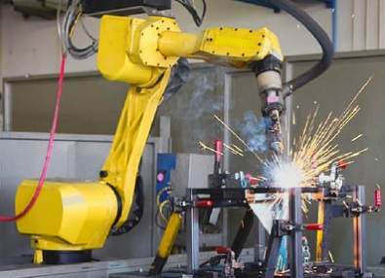
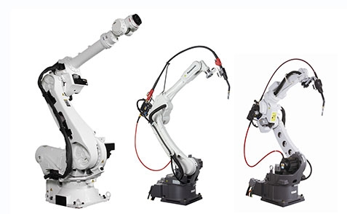
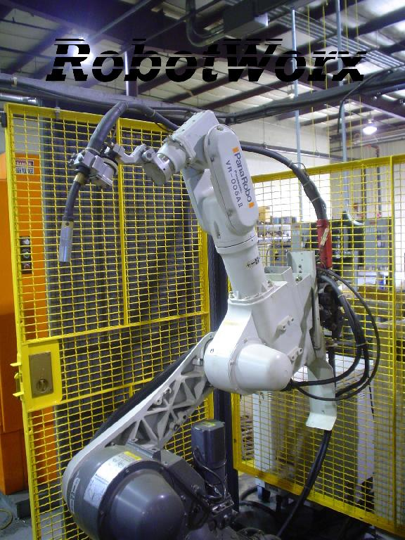
Arm Construction

Slide 12
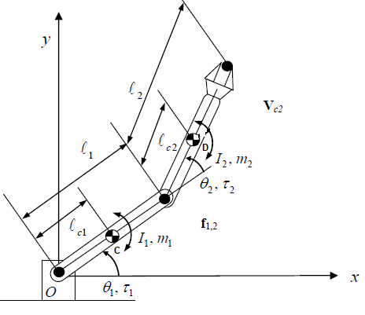
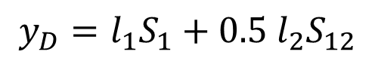
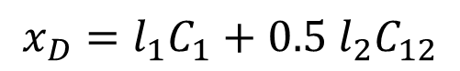
Dynamic Model of a 2 dof R-R Manipulator
$$x_{D}=l_{1}C_{1}+0.5 l_{2}C_{12}$$
$$y_{D}=l_{1}S_{1}+0.5 l_{2}S_{12}$$

Slide 13
Dynamic Model of a 2 dof R-R Manipulator
$$x_{D}=l_{1}C_{1}+0.5 l_{2}C_{12}$$
$$y_{D}=l_{1}S_{1}+0.5 l_{2}S_{12}$$
$${\dot{x}}_{D}={− l}_{1}S_{1}{\dot{θ}}_{1}−0.5 l_{2}S_{12}\left({\dot{θ}}_{1}+{\dot{θ}}_{2}\right)$$
$${\dot{y}}_{D}={ l}_{1}C_{1}{\dot{θ}}_{1}+0.5 l_{2}C_{12}\left({\dot{θ}}_{1}+{\dot{θ}}_{2}\right)$$

Slide 14
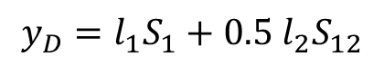
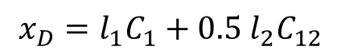
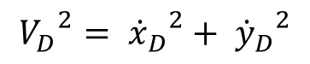
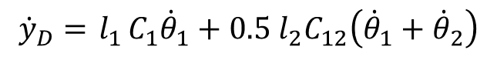
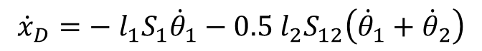
Dynamic Model of a 2 dof Robot
$$x_{D}=l_{1}C_{1}+0.5 l_{2}C_{12}$$
$$y_{D}=l_{1}S_{1}+0.5 l_{2}S_{12}$$
$${\dot{x}}_{D}={− l}_{1}S_{1}{\dot{θ}}_{1}−0.5 l_{2}S_{12}\left({\dot{θ}}_{1}+{\dot{θ}}_{2}\right)$$
$${\dot{y}}_{D}={ l}_{1}C_{1}{\dot{θ}}_{1}+0.5 l_{2}C_{12}\left({\dot{θ}}_{1}+{\dot{θ}}_{2}\right)$$
$${V_{D}}^{2}= {{\dot{x}}_{D}}^{2}+ {{\dot{y}}_{D}}^{2}$$
$${V_{D}}^{2}= {{\dot{θ}}_{1}}^{2}\left( {l_{1}}^{2}+0.25 {l_{2}}^{2}+l_{1}l_{2} cosθ_{2}\right)+{{\dot{θ}}_{2}}^{2}\left(0.25 {l_{2}}^{2}\right)+ {\dot{θ}}_{1}{\dot{θ}}_{2}\left( 0.5 {l_{2}}^{2}+l_{1}l_{2} cosθ_{2}\right)$$

Slide 15

Dynamic Model of a 2 dof R-R Manipulator
Total KE is the sum of KE1 + KE2
$$K_{1}= \frac{1}{2} I_{C} {{\dot{θ}}_{1}}^{2}+ \frac{1}{2} m_{1} {v_{c}}^{2}$$
$$K_{2}= \frac{1}{2} I_{D} {\left({\dot{θ}}_{1}+{\dot{θ}}_{2}\right)}^{2}+ \frac{1}{2} m_{2} {v_{D}}^{2}$$
$K=$ $K_{1}+K_{2}$
$$K= {{\dot{θ}}_{1}}^{2}\left(\frac{1}{6}m_{1}{l_{1}}^{2}+ \frac{1}{6}m_{2}{l_{2}}^{2}+ \frac{1}{2}m_{2}{l_{1}}^{2}+\frac{1}{2}m_{2}l_{1}l_{2}C_{2}\right)+{{\dot{θ}}_{2}}^{2}\left( \frac{1}{6}m_{2}{l_{2}}^{2}\right)$$
$$+{\dot{θ}}_{1}{\dot{θ}}_{2}\left( \frac{1}{2}m_{2}{l_{2}}^{2}+\frac{1}{2}m_{2}l_{1}l_{2}C_{2}\right)$$

Slide 16
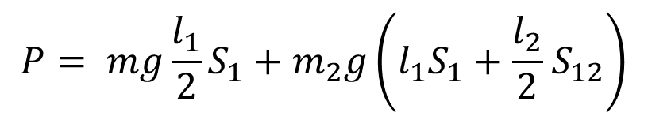
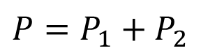
Dynamic Model of a 2 dof R-R Manipulator
Total PE is the sum of PE1 + PE2
$P=$ $P_{1}+P_{2}$
$$P= {mg\frac{l_{1}}{2}S_{1}+m}_{2}g\left(l_{1}S_{1}+\frac{l_{2}}{2}{ S}_{12}\right)$$

Slide 17
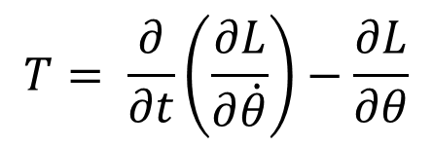
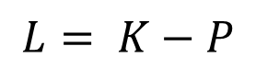
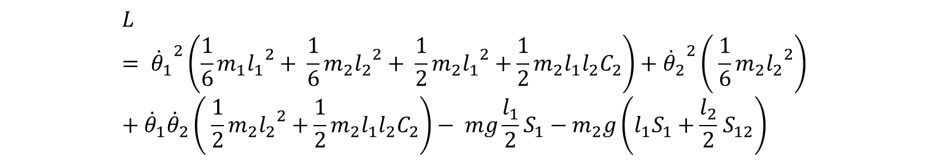
The Lagrangian is given by
$$T= \frac{∂}{∂t}\left(\frac{∂L}{∂\dot{θ}}\right)−\frac{∂L}{∂θ}$$
$$L= K−P$$
$$L= {{\dot{θ}}_{1}}^{2}\left(\frac{1}{6}m_{1}{l_{1}}^{2}+ \frac{1}{6}m_{2}{l_{2}}^{2}+ \frac{1}{2}m_{2}{l_{1}}^{2}+\frac{1}{2}m_{2}l_{1}l_{2}C_{2}\right)+{{\dot{θ}}_{2}}^{2}\left( \frac{1}{6}m_{2}{l_{2}}^{2}\right)+{\dot{θ}}_{1}{\dot{θ}}_{2}\left( \frac{1}{2}m_{2}{l_{2}}^{2}+\frac{1}{2}m_{2}l_{1}l_{2}C_{2}\right)− {mg\frac{l_{1}}{2}S_{1}−m}_{2}g\left(l_{1}S_{1}+\frac{l_{2}}{2}{ S}_{12}\right)$$

Slide 18
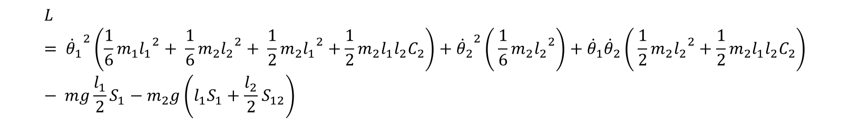
$$L= {{\dot{θ}}_{1}}^{2}\left(\frac{1}{6}m_{1}{l_{1}}^{2}+ \frac{1}{6}m_{2}{l_{2}}^{2}+ \frac{1}{2}m_{2}{l_{1}}^{2}+\frac{1}{2}m_{2}l_{1}l_{2}C_{2}\right)+{{\dot{θ}}_{2}}^{2}\left( \frac{1}{6}m_{2}{l_{2}}^{2}\right)+{\dot{θ}}_{1}{\dot{θ}}_{2}\left( \frac{1}{2}m_{2}{l_{2}}^{2}+\frac{1}{2}m_{2}l_{1}l_{2}C_{2}\right)− {mg\frac{l_{1}}{2}S_{1}−m}_{2}g\left(l_{1}S_{1}+\frac{l_{2}}{2}{ S}_{12}\right)$$

Slide 19
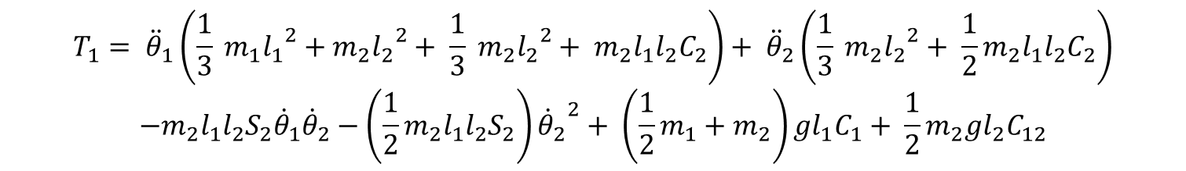
Joint Torques
$$T_{1}= {\ddot{θ}}_{1}\left(\frac{1}{3} m_{1}{l_{1}}^{2}+m_{2}{l_{2}}^{2}+ \frac{1}{3} m_{2}{l_{2}}^{2}+ m_{2}{l_{1}l}_{2}C_{2}\right)+ {\ddot{θ}}_{2}\left(\frac{1}{3} m_{2}{l_{2}}^{2}+ {\frac{1}{2}m}_{2}{l_{1}l}_{2}C_{2}\right)$$
$$−m_{2}{l_{1}l}_{2}S_{2}{\dot{θ}}_{1}{\dot{θ}}_{2}−\left({\frac{1}{2}m}_{2}{l_{1}l}_{2}S_{2}\right){{\dot{θ}}_{2}}^{2}+ \left({\frac{1}{2}m}_{1}+m_{2}\right)gl_{1}C_{1}+ \frac{1}{2}m_{2}gl_{2}C_{12}$$
$$T_{2}= {\ddot{θ}}_{1}\left(\frac{1}{3}m_{2}{l_{2}}^{2}+ \frac{1}{2}m_{2}{l_{1}l}_{2}C_{2}\right)+ {\ddot{θ}}_{2}\left(\frac{1}{3} m_{2}{l_{2}}^{2}\right)+\left({\frac{1}{2}m}_{2}{l_{1}l}_{2}S_{2}\right){{\dot{θ}}_{1}}^{2}+ \frac{1}{2}m_{2}gl_{2}C_{12}$$

Slide 20
THANK YOU
The presenter is grateful to the authors of the following textbooks.
Industrial Robotics - Mikell P. Groover
Fundamentals of Robotics – Robert Schilling
Industrial Robotics Wesley Snyder

